Slide 1



The System of Education
in Spain
Erasmus + Programme – VETPRO Study Visit

Slide 2


Political divisions of Spain
17 regional communities
52 provinces
2 autonomous cities located on
the north coast of Africa: Ceuta and Melilla
Erasmus + Programme – VETPRO Study Visit

Slide 3
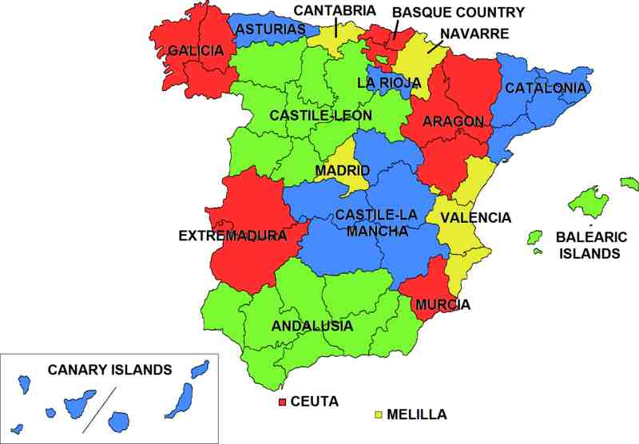
Regional communities
Erasmus + Programme – VETPRO Study Visit

Slide 4

Model of education in Spain
In Spain the model of education is decentralised.
Responsibility is divided between:
Government
Regional communities
Local administration
Schools
Each administrative level has its own responsibilities
In recent years, attempts are made to reform the educational system, but politicians cannot agree on how specific law should be in this area
Erasmus + Programme – VETPRO Study Visit

Slide 5
Educational system
Preschool (educación infantil), divided in two cycles:
until 3 years– nursery school
3-6 years– kindergarten
Primary school (educación primaria): 6-12 years
Secondary school (educación secundaria), divided in:
Obligatory secondary school (educación secundaria obligatoria E.S.O.), 12-16 years
Baccaulerate (bachillerato L.O.G.S.E.), 16-18 years
or
Middle Grade Training Cycles (formación profesional de grado medio)
Superior Level Training Cycles (formación profesional de grado superior)
Higher education (educación universitaria)
Erasmus + Programme – VETPRO Study Visit

Slide 6

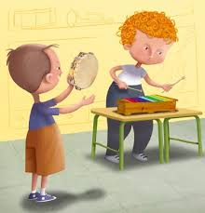
The specialist education
Enseñanza de régimen especial
Art schools (enseñanzas artísticas)
Public aeronautical school
Music school
Military academy
Language schools (enseñanzas de idiomas)
Erasmus + Programme – VETPRO Study Visit

Slide 7

Catholic Schools
Mainly founded in the nineteenth century by a variety of male and female religious orders
They are very popular and offer solid teaching
The government aids these schools by subsidies
The government requires in return from these schools that they adhere strictly to the general curriculum
Erasmus + Programme – VETPRO Study Visit

Slide 8
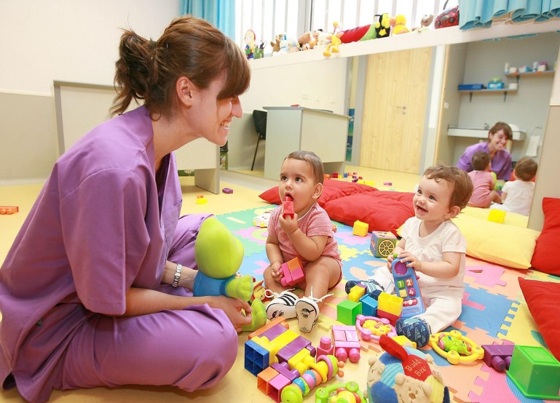
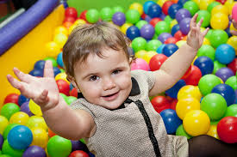
Preschool Education
Preschool education is not obligatory.
Already in this period, children are gradually familiarized with letters and numbers, as well as foreign languages.
Erasmus + Programme – VETPRO Study Visit

Slide 9

Primary School
Duration of primary education is 6 years and is divided in three 2-years cycles.
Education is organized in 5 obligatory ranges:
Spanish and local language;
Natural, Social and Cultural Environment;
Mathematics;
Art education;
Physical education;
Foreign languages.
In all the cycles religion lessons are optional, so that students can also participate in replacement activities. The promotion is every two years.
Erasmus + Programme – VETPRO Study Visit

Slide 10
Obligatory Secondary School
Secondary schools are attended by children between 12 and 16 years old. E.S.O. is a novelty: a four-year school introduced with the intention to extend the obligation of education to 16 years old (then it is possible to start to work), as well as giving the opportunity to choose a further course of education - Baccalaureate and graduate or professional training.
Obligatory Secondary School (E.S.O.) is divided in two parts:
first two courses are general,
in the third course students can choose between science and humanistic branch (itinerario científico-humanístico) and technological branch (itinerario tecnológico),
In the fourth course students can choose between science, humanistic or technological branch, and they specialize more. The rating scale is made up of ten grades.
After school the student receives a kind of guide to choose further education and career . This document, which is confidential, is prepared by an educator with counseling with a psychologist, and other teachers. They advise the student how to use their talents and achievements.
After E.S.O. the student has three possibilities: start to work, start a professional training or start a 2-years education in high school with a Baccalaureate.
Erasmus + Programme – VETPRO Study Visit

Slide 11


Baccalaureate or vocational education
Third and not obligatory level of education.
Includes:
Baccalaureate Schools
or
Vocational education schools
Middle Grade Training Cycles
Middle Grade Training Cycles
(special regime education )
Erasmus + Programme – VETPRO Study Visit

Slide 12

Higher Education
Higher education: universities (enseñanzas universitarias),
Superior-level Training Cycles (Ciclos Formativos de grado superior),
Superior-level of Arts (Enseñanzas Artísticas Superiores),
Superior-level of Plastic arts and design
Superior-level of Sport Education
Erasmus + Programme – VETPRO Study Visit

Slide 13
The reform:
dual system
Considerations on the subject began in the 2011/2012 , but there has been little progress in implementation of this system.
Some of the autonomous communities in the school year 2011/2012 introduced a dual system as an experiment.
The experiment was carried out in two schools of vocational education at the advanced level (fields: aeronautics and IT)
Students were selected by the company, received remuneration in the form of a scholarship (450 Euro), work time was dependent on the direction of the company and business sector
In some cases, students worked in the morning and in the afternoon attended classes
Companies received financial incentives for accepting the trainee
In the school year 2012/2013 in the experiment involved six schools and concerned 14 courses in the vocational education at the advanced level
Erasmus + Programme – VETPRO Study Visit

Slide 14
Overall
Compulsory education starts at age 6 years
Compulsory education lasts for 11 years
The school year is divided into 3 semesters
Learning period begins in mid-September and ends in mid-June
Financing and financial management allocated to education in Spain is decentralized
Regional Communities may establish the procedure for financing education by their own
Erasmus + Programme – VETPRO Study Visit

Slide 15
The System of Education in Spain - scheme
UNIVERSITY
LABOUR
MARKET
SUPERIOR LEVEL OF VOCATIONAL TRAINING
F.P.E.
HIGH SCHOOL (BACCALAUREATE)
16-18 years
MIDDLE GRADE OF VOCATIONAL TRAINING
Erasmus + Programme – VETPRO Study Visit
OBLIGATORY SECONDARY SCHOOL
12- 16 years
PROGRAMS OF SOCIAL SECURITY
PRIMARY SCHOOL
6 - 12 years
PRESCHOOL
0 - 6 years

Slide 16
The system of education in Spain- Baccalaureate
Baccalaureate – Prueba General de Bachillerato, P.G.B. – covers a part common to all profiles, and a part corresponding to individual profiles, as well as a foreign language (oral and written). You can approach it four times. The results are valid throughout the European Union. The final grade, which will be placed on the certificate consists of a high school grade point average and grade from baccalaureate exam. Baccalaureate is necessary both to seek admission to higher education and superior level of vocational training.
Erasmus + Programme – VETPRO Study Visit

Slide 17
The system of education in Spain- Vocational training
Vocational training takes place in two cycles: the principal– formación profesional de grado medio – can replace the high school and end up with the title of a technician (técnico). Second - formación profesional de grado superior – is post- high school education and carries the title of the second stage technician (técnico superior).
Erasmus + Programme – VETPRO Study Visit

Slide 18
The system of education in Spain- University
In order to go to university, you must pass the exam– Prueba de Acceso.
It lasts three days, in which several exams take place (from one up to three per day). It is divided into two parts: the first is of general subjects and it also includes a foreign language while the other depends on the profile chosen by the candidate in high school. You can choose one of five options :
Vía Científico-Tecnológica – scientific and technical exam in mathematics and physics
Vía de Ciencias de la Salud – medical exam in biology and chemistry
Vía de Humanidades – humanistic exam in Latin and history of art
Vía de Ciencias Sociales – exam of the social sciences, applied mathematics in the social sciences and geography
Vía de Artes – exam of art drawing and art history
Recruitment takes place in two rounds: ordinary and extraordinary. The candidate may attempt the exam four times.
Erasmus + Programme – VETPRO Study Visit

Slide 19
The system of education in Spain
- Vocational training (more)
Vocational training education depends on the autonomous region. Specialist Vocational training education is divided into two stages and each stage has different criteria for admission.
MIDDLE GRADE OF VOCATIONAL TRAINING
You can get it after receiving the title of obligatory secondary school or approaching middle-level entrance exam (you must be over 17 years). After completion of education you obtain the title of technician in the field, which is studied.
SUPERIOR LEVEL OF VOCATIONAL TRAINING
You can get after receiving the title of Baccalaureate. Another option is to pass the exam on the higher degree (must be over 19 years or 18, and you have the title of middle grade of vocational education, linked to what we want to study).
Erasmus + Programme – VETPRO Study Visit

Slide 20
The system of education in Spain
- Vocational training
a wyą uczelnię z poziomu szkolenia zawodowego
Assessment on which candidate is accepted at university is set on the base of the average of all the modules of the whole cycle.
In the case of studies in fields where there are more applicants than places, applications will be ordered according to the ratings (the first person with the best results).
In the case of "tie" priority is given to the person whose title level of professional higher education belongs to the same branch of knowledge of the direction you want to study.
If you wish to improve the assessment, the person with the title of the higher vocational training can improve its assessment, according to the university entrance exam.
Erasmus + Programme – VETPRO Study Visit

Slide 21
The system of education in Spain
- Vocational training
How to get on the middle grade of vocational training?
CONDITIONS TO BE FULFILLED:
Hold the title of high school.
Hold the title of technician or assistant technician.
Pass the second year of the course Baccalaureate
Pass an entrance exam at the middle grade of vocational training
How to get on the superior level of vocational training?
Hold the title of high school (Baccalaureate)
Hold the title of senior technician or technician specialist degree
Have passed Curso de Orientación Universitaria (COU) – a course of preparation for higher education
Pass an entrance exam at the superior level of vocational training
Erasmus + Programme – VETPRO Study Visit

Slide 22
The system of education in Spain
- Vocational training
The characteristics of training in the workplace
Previously planned and mandatory to obtain the title
This module is carried out in companies, where you can observe classes specific to the position and perform them yourself and learn about the organization of the production process or service and employee relations.
Trainee is supervised by two tutors throughout the training process:
Professor-tutor (the training center).
Tutor or instructor (with the cooperating company).
After completion of the learning process, the student should acquire a series of skills
Erasmus + Programme – VETPRO Study Visit

Slide 23

Thank you for attention
Erasmus + Programme – VETPRO Study Visit

