Slide 1
Training
Welcome
Presentation
LLP & Erasmus + Programmes

Slide 2
Group Training in Spanish VET school
Located in Seville.
The trainees train together in one group under the supervision of a VET school Tutor and a euroMind Interpreter.
LLP & Erasmus + Programmes

Slide 3
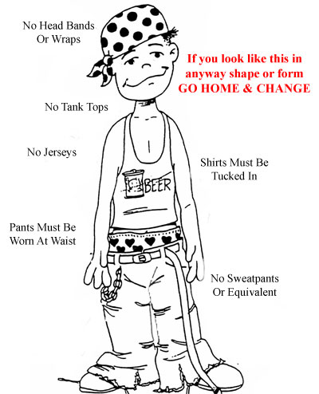
Work Dress Code
Your dress code depends on the sector in which you will be training.
In most workplaces casual clothing is acceptable.
However, please do not violate certain standards, and come to work wearing flip-flops, tracksuits, T-shirts with inscriptions and lots of pictures, low-waist & saggy trousers, glaringly bright coloured trousers, short dresses or mini-skirts showing a lot of legs and bust.
Just to be on the safe side, it’s better to tone down your clothing for work!
If your job requires a special uniform and equipment, please bring it with you.
LLP & Erasmus + Programmes

Slide 4
Work culture
Shops are usually open from 9:00 am to 1:30 or 2 pm, then from 4:30 or 5 pm until 8 pm, Monday through Friday, and Saturday morning.
Large department stores are open all day.
The break from 2 to 5 p.m. is called SIESTA.
It is a short nap taken in the early afternoon, often after the midday meal.
Such a period of sleep is a common tradition in those countries where the weather is warm like Spain.
Your training hours will be from 15:30 until 20:30
LLP & Erasmus + Programmes

Slide 5
Spanish Climate
The summers are very hot.
The temepratures can reach 40 ⁰ C in August.
It is very important to drink a lot of fluids in the summer period.
The springs and autumns are usually very short and temperature flactuations in those periods are quite drastic.
In winter in the south of Spain although the temeratures normally never drop lower than
– 1 ⁰C, the thermic sensation is quite low.
Please be prepared for a lot of rain and cold weather in the winter period.
LLP & Erasmus + Programmes

Slide 6
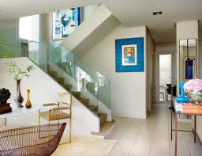
Spanish Houses
They are constructed with the aim of keeping the warm out and not keeping it in.
The floors are covered with tiles or murble to give the cooling sensation in the summer.
In the winter period, such floors intensify the feeling of cold.
Some of the rooms look out onto interior patios which are not so well lit like the rooms looking out onto the exterior streets.
LLP & Erasmus + Programmes

Slide 7
Spanish Food
It differes quite a lot from the cuisine of the rest of Europe.
It contains a lof of sea food. But do not worry, it is normally never served by us or our host families, unless the students ask for it.
The most typical form of having food is tapas – small portions served with a drink in a bar.
To dress salads the Spanish use olive oil and vinagre.
A lot of food is served cold. You can find cold tomatoe soup called Gazpacho or potatoe sald with tuna and maise.
The Spanish eat a lot of food deep-fried in olive oil.
LLP & Erasmus + Programmes
LLP & Erasmus + Programmes

Slide 8
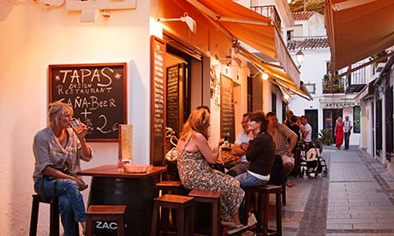
Spanish Lifestyle
Much of Spanish life is lived in the streets and the atmosphere is especially vibrant at fiesta.
On a warm evening the street cafes and bars can fill to capacity as people sit and relax.
The Spanish way of life is somewhat slower than the rest of Europe, especially in the south.
LLP & Erasmus + Programmes

Slide 9
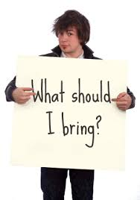
What to bring?
In the summer period:
light clothing
flip-flops for the swimming pool
flip-flops for the house
suncream with a high SPF (Sun Protetcion Factor)
beach towel
hat if you have a very pale complexion
In the winter period:
warm clothing
long-sleveed warm pyjamas
warm sleepers
warm hat
scarf
warm coat or jacket
umbrella
LLP & Erasmus + Programmes

Slide 10
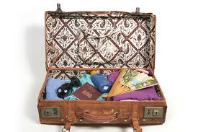
What else will I need?
LAPTOP
As all of our accommodation has Internet access, a good idea might be to bring a laptop.
ADAPTORS
The UK & Irish trainees can’t forget to bring adaptors with them for their plugs.
MOTIVATION
It is very important that you bring with you a lot of motivation and wilingness to cooperate and take the most of out this work experience. It is a once in a lifetime opportunity.
LLP & Erasmus + Programmes

Slide 11
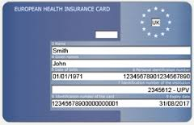
Healthcare in Spain
Nationals of EU countries can get free medical treatment in Spain on production of European Health Insurance Card.
Please do not forget to bring it with you. Otherwise we will have to wait much longer for the doctor to receive you.
LLP & Erasmus + Programmes

Slide 12
Money & Banks
There is a wide array of banks in Ubeda. To name a few: Unicaja, Caja Rural, Santander, Caja Granada, Caja Sur, La Caixa, Caja de Jaen, etc.
You can withdraw money from any ATM. However, when using ATMs you need to check what the charges are as they vary between the systems.
LLP & Erasmus + Programmes

Slide 13
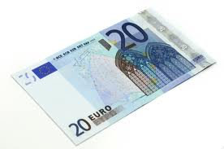
Accommodation deposit
On the day of their arrival, the trainees will be asked for a 20 Euro deposit to cover small damages.
In case there were serious damages, the trainee is obligated to pay for the purchase of a new piece of equipment
The deposit will be returned to the participants in full at the end of their stay in Seville only if during the final accomodation check no damages are noticed
LLP & Erasmus + Programmes

Slide 14
Laundry
Laundry cost: 2.5 Euros per one load.
Students need to provide washing liquid.
LLP & Erasmus + Programmes

Slide 15
Bath & Hand Towels
If the trainee decides to use accommodation towels, he/ she needs to know that:
towels (one big and one small) can be rented at an additional cost of 2,5 E per each set (loundry fee). Once used, they must be returned to the accommodation staff in useable condition. In other words, the towels can’t be used for cleaning shoes, mascara; floor and any other objects which should not be dried with a towel.
If preferred, participants can bring their own towels.
LLP & Erasmus + Programmes

Slide 16
Entertainment
Apart from numerous bars, cafes and restaurants, Seville has lots to offer in terms of entertainment facilities such as cinema, bowling, sports centre, skating, open air swimming pool, festivals, etc.
LLP & Erasmus + Programmes

Slide 17
Post Office
Opening times:
Monday - Friday: 8:30-20:30 Saturdays: 9:30-13:00 Sundays: closed
Please note if you want to send a postcard or a letter you can easily buy a stamp at any kiosk.
The European Union stamp costs 70 cents.
Post boxes can be found in many places around Seville so it is not always necessary to go the post office, unless you want to send a parcel or a certified letter.
LLP & Erasmus + Programmes

Slide 18
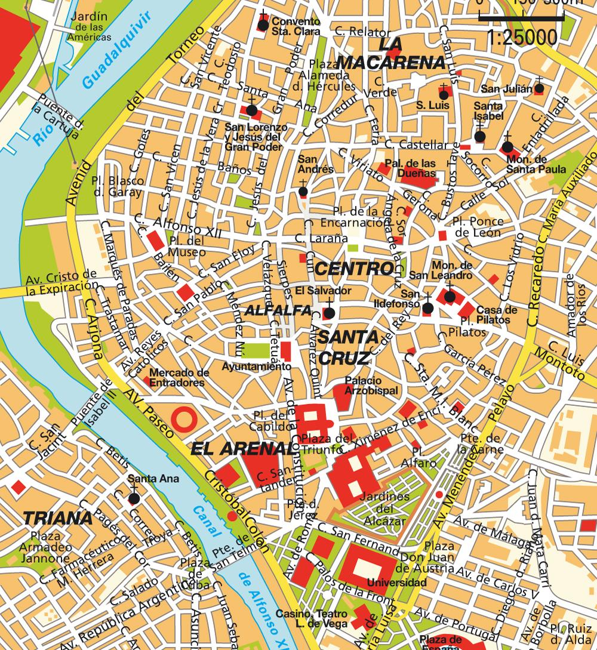
Seville Old Town
Seville monumets that you cannot miss!
Giralda tower
Alcázar Palace - Los Reales Alcázares
The Seville Cathedral
The Gold Tower - La Torre de Oro
The Spanish Square - Plaza de España
LLP & Erasmus + Programmes

Slide 19
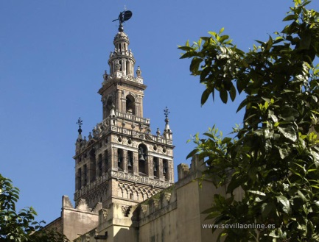
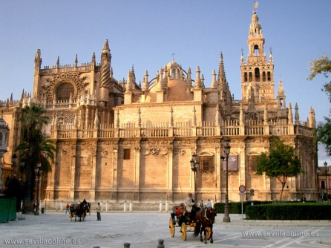
Old Town Heritage
Sevilla Cathedral
The Cathedral of Saint Mary of the See, better known as Seville Cathedral, is a Roman Catholic cathedral in Seville. It is the largest Gothic cathedral and the third-largest church in the world (See right and below).
LLP & Erasmus + Programmes
Giralda Tower
The Giralda is a former minaret that was converted to a bell tower for the Cathedral of Seville in Seville, which was registered in 1987 as a World Heritage Site by UNESCO along with the Alcazar and the General Archive of the Indies

Slide 20
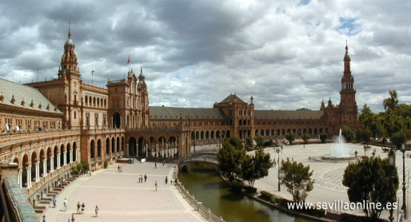
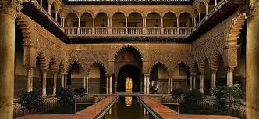
Old Town Heritage
The Spanish Square
The Plaza de España ("Spain Square", in English) is a plaza located in the Parque de María Luisa (Maria Luisa Park), in Seville, Spain built in 1928 for the Ibero-American Exposition of 1929. It is a landmark example of the Renaissance Revival style in Spanish architecture.
LLP & Erasmus + Programmes
The Alcázar of Seville
It is a royal palace in Seville, Spain, originally a Moorish fort. It is the oldest royal palace still in use in Europe, and it was registered in 1987 by UNESCO as a World Heritage Site.

Slide 21
Emergency Numbers
euroMind Staff
+34 627050073 - Amelia
+34 647901808 – Carlos
Project Coordinator’s number will be provided by Project Coordinator
Police 112 Ambulance 112 Fire Brigade 112 Tourist health care services 112
LLP & Erasmus + Programmes

Slide 22
Thank you euroMind Team
Training Welcome Presentation
LLP & Erasmus + Programmes
Leonardo da Vinci Programme – VETPRO Study Visit

