Slide 1



SPANISH MEDICAL SYSTEM: NURSERY AND PHISIOTHERAPY
Erasmus + Programme – VETPRO Study Visit

Slide 2


Medical System
“A set or series of interconnected or interdependent parts or entities (organisms) that act together in a common purpose or produce results impossible by action of one alone.”
Erasmus + Programme – VETPRO Study Visit

Slide 3
- Spanish healthcare consists of both private and public healthcare, with some hospitals and healthcare centres offering both private and state healthcare services. You don’t need to have private health insurance to get medical treatment (usually allows you to get faster treatment for non-emergency procedures).
- State healthcare is free of charge to anyone living and working in Spain, although in some of the Spanish islands you may have to travel to find a state healthcare provider.
- As an expat, you are entitled to free state healthcare if you are: resident in Spain and work in employment or self-employment and pay social security contributions, resident in Spain and receiving certain state benefits, resident in Spain and recently divorced or separated from a partner registered with social security, a child resident in Spain, a pregnant woman who is resident in Spain, under 26 and studying in Spain, a state pensioner, or staying temporarily in Spain and have an EHIC card (European Health Insurance Card).
Medical System in Spain
Erasmus + Programme – VETPRO Study Visit

Slide 4
Public healthcare in Spain
You must register with social security to get a social security number. You’ll need to show your passport or ID card, residency certificate and a completed application form. You’ll also need to have registered your details (address etc.) at your town hall.
Once you have registered with the TGSS you’ll be given a social security number and a certificate stating that you’re entitled to medical help. You then take the certificate, passport and NIE number (foreigner’s identity number) along to your local health centre. You can then register with a doctor and apply for a health card. You’ll need to show it every time you visit a clinic, hospital or collect a prescription from a pharmacy.
In Spain, you get primary heath care through a health centre, or a general doctor. Before you can see a doctor, you’ll need to register.
If you want to be seen by a medical specialist in Spain you’ll need to be referred by a family doctor. If you have private health insurance, you’ll be able to see a specialist much faster than going through the public system.
In an emergency you can go straight to a hospital .
If you want to get any other type of hospital treatment, you’ll need a referral from a doctor. There are public and private hospitals. Only the public hospitals provide free treatment. Some hospitals offer both private and state healthcare services , so make sure the staff knows which service you want.
When you go to hospital you’ll need to show your social security card or proof of private insurance.
If you are discharged from a hospital and need medication, you have to take the hospital medical report to a pharmacy for the prescription to be fulfilled, as hospital doctors don’t issue prescriptions.
You can take a prescription to any pharmacy. Look for a shop with a large green cross sign outside.
Erasmus + Programme – VETPRO Study Visit

Slide 5

Private healthcare in Spain
If you are not paying social security contributions, then you can choose to take out private health insurance or pay the full amount of any medical costs.
Some examples:
Erasmus + Programme – VETPRO Study Visit

Slide 6
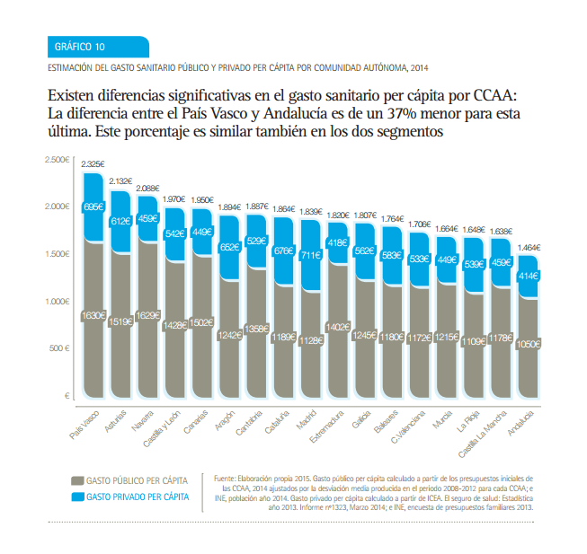
Private Healthcare Costs Vs Public Healthcare Costs

Slide 7
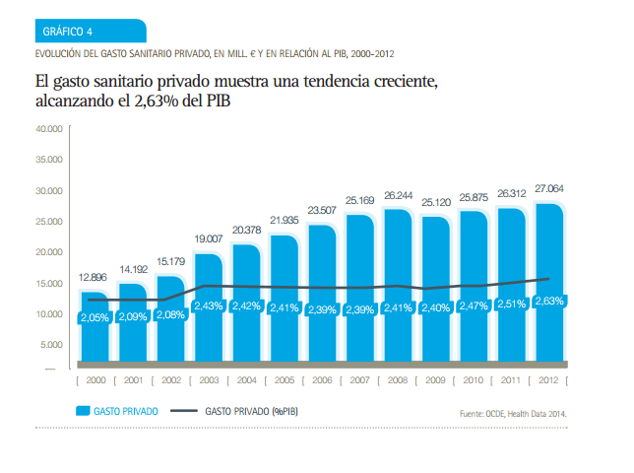
Evolution Private Healthcare Costs (Spain)

Slide 8
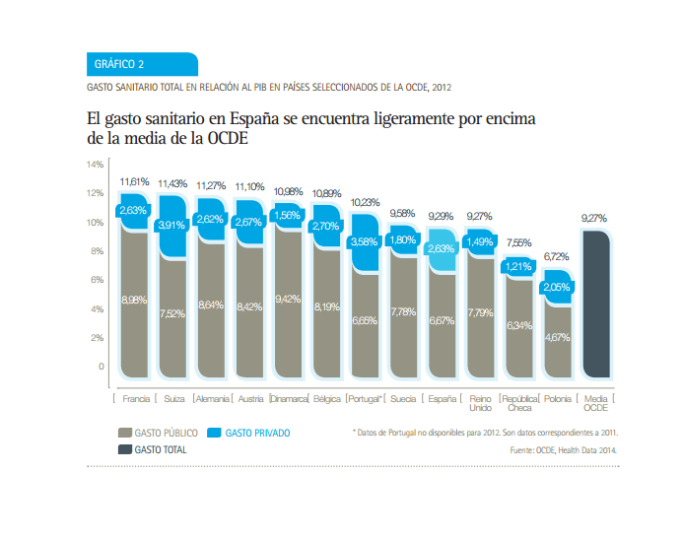
Public Healthcare Costs (Spain) Vs OECD
OCDE(Organización para la Cooperación y el Desarrollo)
OECD(Organisation for Economic Co-operation and Development)

Slide 9
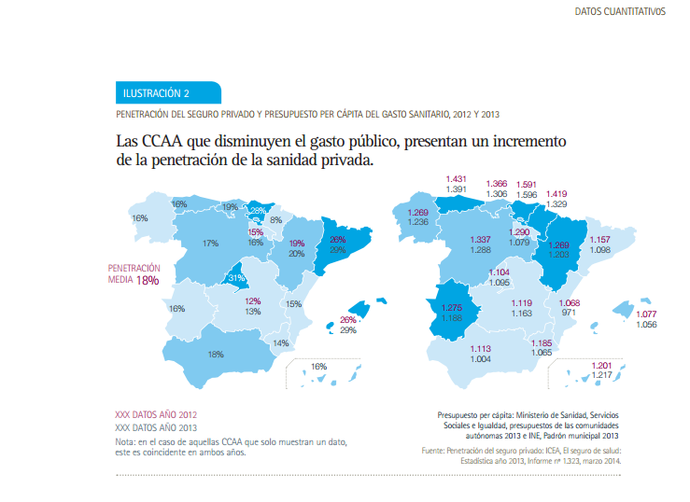
Increase of Private Healthcare Costs due to a decrease of Public Healthcare Costs

Slide 10
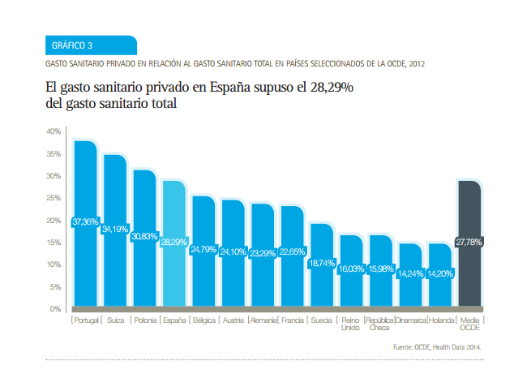
Private Healthcare Costs (Spain) Vs OECD

Slide 11
Useful Spanish phrases in an emergency
Accident: Accidente
Emergency: Emergencia/Urgencia
I need an ambulance: Necesito una ambulancia
I need a doctor: Necesito un medico
Heart attack: Ataque cardiaco/Infarto
Stroke: El accidente vascular cerebral
I need a dentist: Necesito un dentista

Slide 12

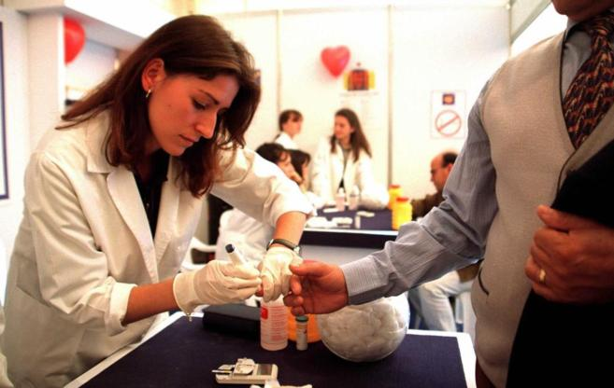
Nursery
STUDIES:
Nursing studies in our country lead to obtaining a four year degree and 240 ECTS or European credits .
The total count is around 6,200 hours of teaching , including lectures, seminars, labs , staff workload and especially 2300 hours of care practices . Studies are held in public, private and university centers attached to universities.
700 - 1. 000 € per year.
LAST STATISTICS:
We have 508 nurses per 100.000 residents.
The European Average is 801 per 100.000 residents.
We would need 141.783 nurses to get de European average.
Other countries are beginning to take advantage of the human resources that Spain is not the way to use. This human resources are especially valued abroad for its excellent training, as complete as diversified .
Lots of nurses are working abroad. Nearly 5.000 nurse left Spain to work abroad in the last 5 years.
- Mainly UK and France.
- Better income.
- Accomodation.
- Better conditions
Erasmus + Programme – VETPRO Study Visit

Slide 13

Physiotherapy
STUDIES:
Physiotherapy studies in our country lead to obtaining a four year degree and 240 ECTS or European credits . The involves an intensive theoretical and practical training in all types of physical therapy , which empowers physical therapists to deal with all scientific and technical guarantees a multitude of diseases to achieve speed up the recovery process by applying the knowledge acquired.
LAST STATISTICS:
Only 32% say they work a full 40 hours compared with 55% of those working less than 40 hours.
Many who say they work less than 40 hours, they are working in 2 different companies, with the difficulties that this entails in terms of tax and personal level.
The income is less than 1,000 euros a month. They are healthcare professionals, often highly trained, whose salaries are lower than many professions that do not need any qualifications, and have the responsibilities of a physiotherapist.
Most of them, are working as autonomous follow by whose are working as employees.
Many physiotherapy centers have closed in this period of crisis, and many others only survive such , which are needed less physiotherapists , since the public offering has not increased . But instead, each year an average of 100 out physios college graduates , and this does not stop. The consequent is the saturation of the labor market .
44% of physiotherapists accept or accepted the contract proposed to them without knowing what their rights and wage law.
Many physiotherapists leave our country to work abroad:
-Better income.
- Accomodation.
- Better conditions
Erasmus + Programme – VETPRO Study Visit

Slide 14
CROATIA
What is the situation in your country?
Public healthcare
Private healthcare
Nursery
Physiotherapy

Slide 15
Conclusions
Medical System in Spain: Public healthcare and Private healthcare.
Private Healthcare Costs Vs Public Healthcare Costs : Public Healthcare Costs > Private Healthcare Costs.
Evolution Private Healthcare Costs (Spain): Private Healthcare Costs are increasing every year.
Public Healthcare Costs (Spain) Vs OECD: Public Healthcare Costs > OECD.
Increase of Private Healthcare Costs due to a decrease of Public Healthcare Costs.
Private Healthcare Costs (Spain) Vs OECD: Private Healthcare Costs > OECD.
We have learned some useful expressions , Do you remeber them?.
Nursery.
Physiotherapy.
Croatia.
Erasmus + Programme – VETPRO Study Visit

Slide 16

Thank you for attention
Erasmus + Programme – VETPRO Study Visit

